Slide 1
Introduction to Bayesian Modeling

Slide 2
What is Bayesian Modeling?
Bayesian modeling is the statistical framework for updating belief about unknown parameters given observed data using Bayes’ Theorem
You begin with some belief (prior) and the model for the data generation process (likelihood). Then you update the belief based on the data (posterior)
Bayesian analysis is a complete workflow for conducting statistical analysis that encompasses Bayesian inference but also includes prior selection, model building, model fitting, diagnostics, etc.
In this workshop, you will learn:
Bayesian inference fundamentals
Bayesian Analysis workflow
How to run Bayesian analysis in R using <<brms>>

Slide 3


Building Intuition of Bayes’ Theorem
Suppose you get a text from an unknown number
It could be one of your friends who visits occasionally, or it could be a spam. What’s your initial intuition?
Hey it’s me Alex, want to grab some coffee?

Slide 4
Building Intuition of Bayes’ Theorem
Now you check the area code, and it’s from a place that Alex is in – and you vaguely remember them mentioning about visiting you. Does that change your belief?
From: 217-xxx-xxxx
Hey it’s me Alex, want to grab some coffee?

Slide 5
Building Intuition of Bayes’ Theorem
You text back asking about the usual coffee spot. They text back with the correct spot. How does that update your belief?
From: 217-xxx-xxxx
Hey it’s me Alex, want to grab some coffee?
What’s the spot that we usually go to?
From: 217-xxx-xxxx
Coralie on Davis!

Slide 6
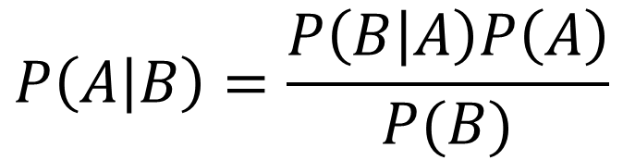
Bayes’ Theorem
$$P\left(A | B\right)=\frac{P\left(B | A\right)P\left(A\right)}{P(B)}$$
In the example above, A and B denote some event of interest
P(A|B) is conditional probability: Given that B has already happened, what is the probability of A?
Bayes’ theorem gives a mathematical rule for inverting the conditional probabilities
This is a mathematical fact: no dispute here!
Proof here

Slide 7

Bayesian Theorem in Action
Suppose you roll a fair six sided die
does P(Roll 6 | Number is even) = P(Number is even | Roll 6)?

Slide 8

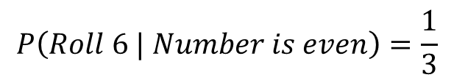

Bayes’ Theorem in Action
Suppose you roll a fair six sided die
does P(Roll 6 | Number is even) = P(Number is even | Roll 6)? No!
$$P\left(Roll 6 | Number is even\right)=\frac{1}{3}$$
$$P\left(Roll 6\right)=\frac{1}{6}$$
$$P\left(Number is even | Roll 6\right)=1$$

Slide 9
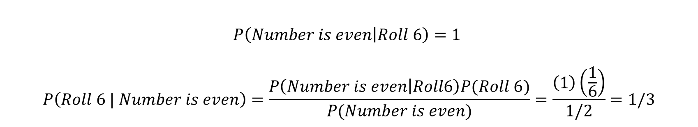
Bayes’ Theorem in Action
Suppose you roll a fair six sided die
does P(Roll 6 | Number is even) = P(Number is even | Roll 6)? No!
$$P\left(Number is even | Roll 6\right)=1$$
$$P\left(Roll 6 | Number is even\right)=\frac{P\left(Number is even | Roll6\right)P(Roll 6)}{P(Number is even)}=\frac{\left(1\right)\left(\frac{1}{6}\right)}{1/2}=1/3$$
So how does this help us?

Slide 10
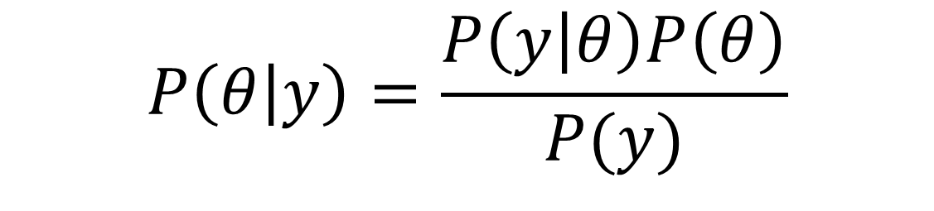
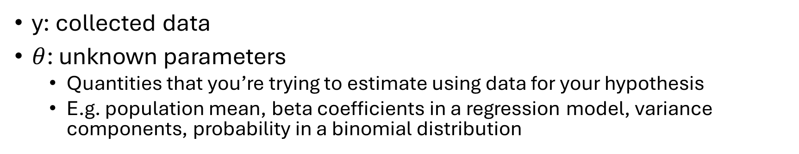
Bayes’ Theorem
Likelihood
Prior
Posterior
$$P\left(θ | y\right)=\frac{P\left(y | θ\right)P\left(θ\right)}{P(y)}$$
Normalizing Constant
y: collected data
$θ$: unknown parameters
Quantities that you’re trying to estimate using data for your hypothesis
E.g. population mean, beta coefficients in a regression model, variance components, probability in a binomial distribution

Slide 11
Bayesian vs Frequentist
 | (1) Probability Interpretation | (2) Treatment of the “unknowns” | Product of the analyses as a result of (1) and (2)
Frequentist | Long-term relative frequency of an outcome | Fixed | P-value Confidence Interval Point estimate
Bayesian | Reflection of a state of mind (i.e. belief, epistemic probability) | Random | Bayes Factor Posterior distribution Credible interval

Slide 12
Why use Bayesian Statistics?
Flexibility in modeling
Intuitive interpretation of the results
Incorporation of domain knowledge through prior
Unknown parameters have full posterior distribution, which leads to…
Analysis can be easily conducted on transformed parameters
“Natural propagation of uncertainty”¹
1. https://paulbuerkner.com/talks/pdf/bayesian_multilevel_modeling_brms.pdf

Slide 13
Drawbacks
Model estimation takes some time, even for relatively simple models
May require additional learning of probabilistic programming language (e.g. Stan) to fully harness the power of Bayesian analysis
Additional steps necessary to check the quality of the draws
Subjectivity in incorporation of priors

Slide 14
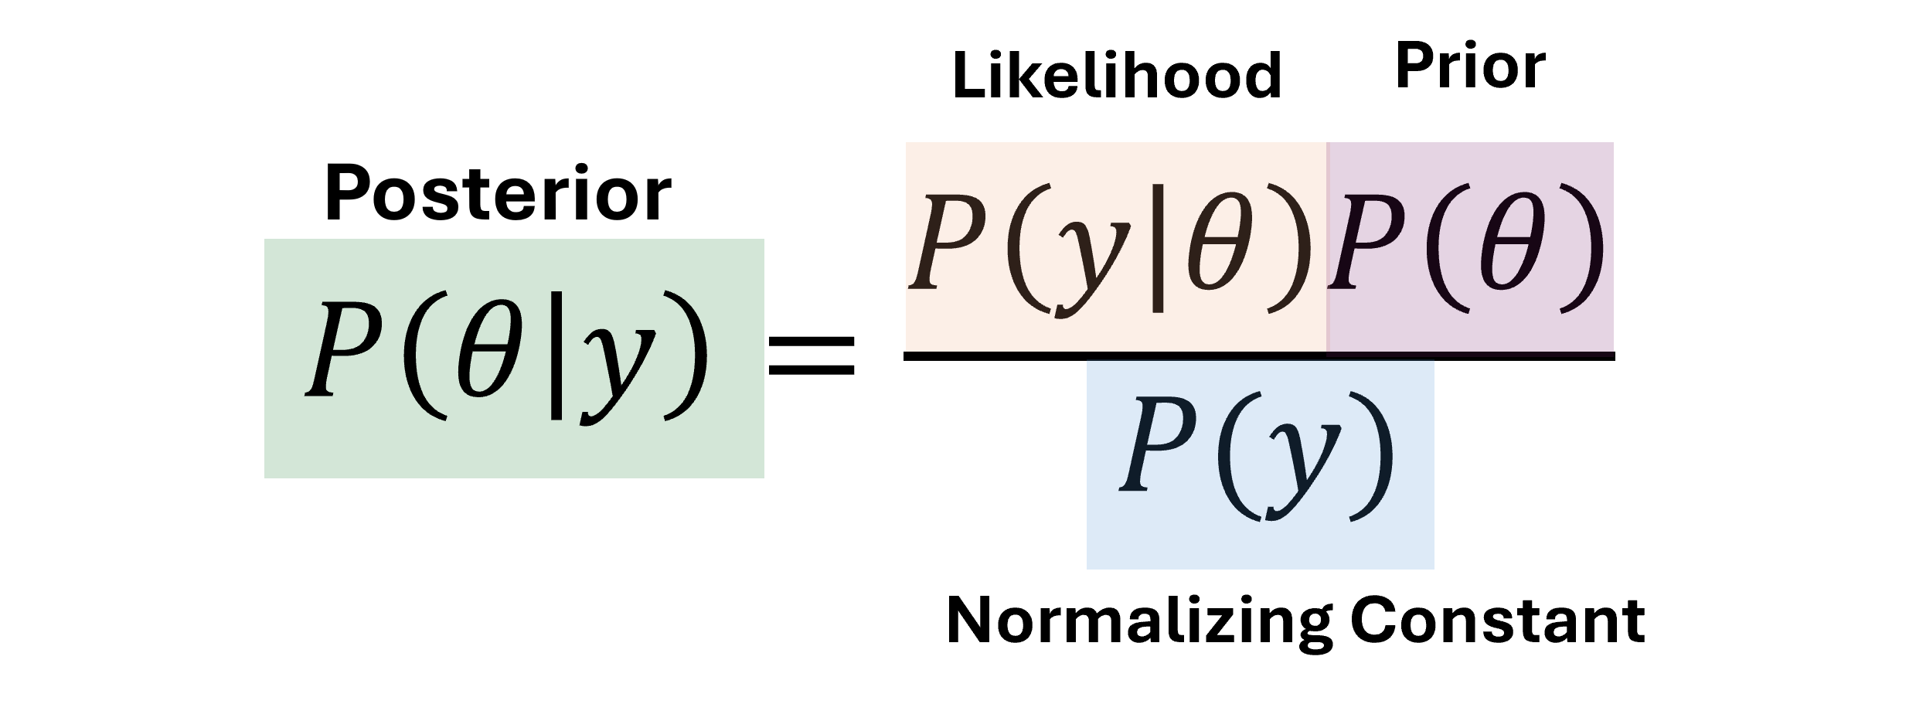

Prior: $P(θ)$
Initial belief about unknown parameters before looking at the data
It can come in many different distributional forms
Normal, exponential, poisson, etc
Incorporation of prior knowledge is the main source of criticism in Bayesian inference

Slide 15
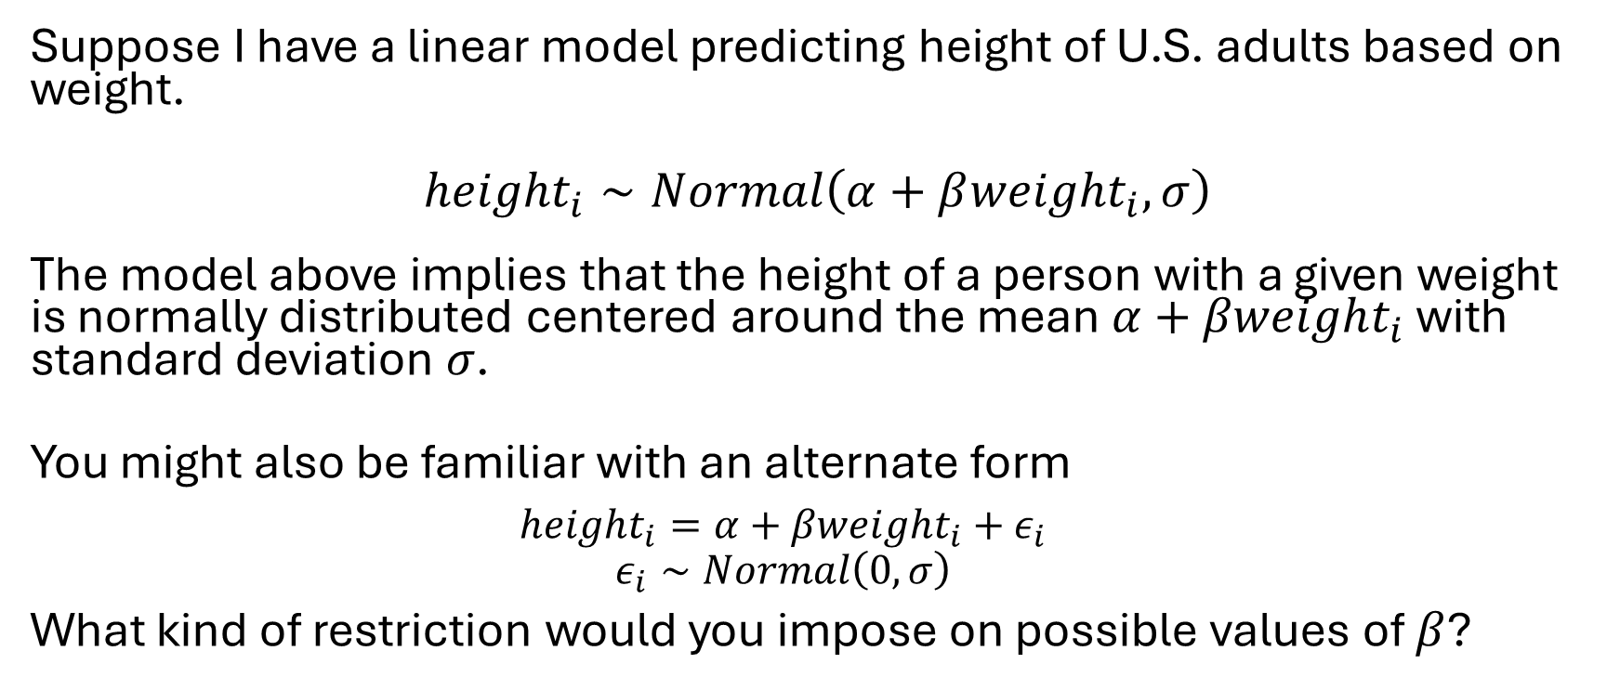

Prior: $P\left(θ\right)$ Exercise
Suppose I have a linear model predicting height of U.S. adults based on weight.
$${height}_{i}∼Normal\left(α+β{weight}_{i}, σ\right)$$
The model above implies that the height of a person with a given weight is normally distributed centered around the mean $α+βweight_{i}$ with standard deviation 𝜎.
You might also be familiar with an alternate form
$$height_{i}=α+βweight_{i}+ε_{i}$$
$$ε_{i}∼Normal\left(0,σ\right)$$
What kind of restriction would you impose on possible values of $β$?

Slide 16
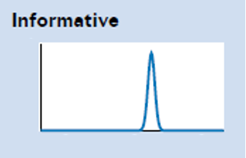
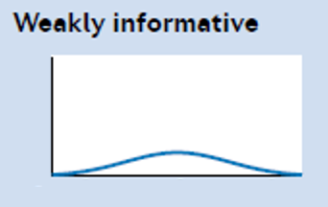
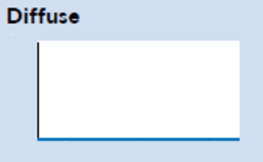
Types of Priors
Broadly classified based on different levels of informativeness
Categorization depends on the context of your data!
Informative: reflects high degree of certainty
Weakly Informative: Incorporates “medium” amount of uncertainty
Diffuse (Non-informative): reflects a great deal of uncertainty about the model parameter

Slide 17
Informative Prior
Reflects high degree of certainty about the model parameters being estimated
There’s some information restricting the possible range or relationship between parameters
It is possible that this can produce a posterior that’s not reflective of the population, so it’s important to measure the effect of prior through sensitivity analysis

Slide 18
Weakly Informative Prior
Incorporates “medium” amount of uncertainty
Compared to the informative priors, the data has more influence on the posterior distribution
When some information is assumed about a parameter, but you still want to incorporate some uncertainty
Use to specify plausible parameter space and exclude implausible values by limiting density mass at those space

Slide 19
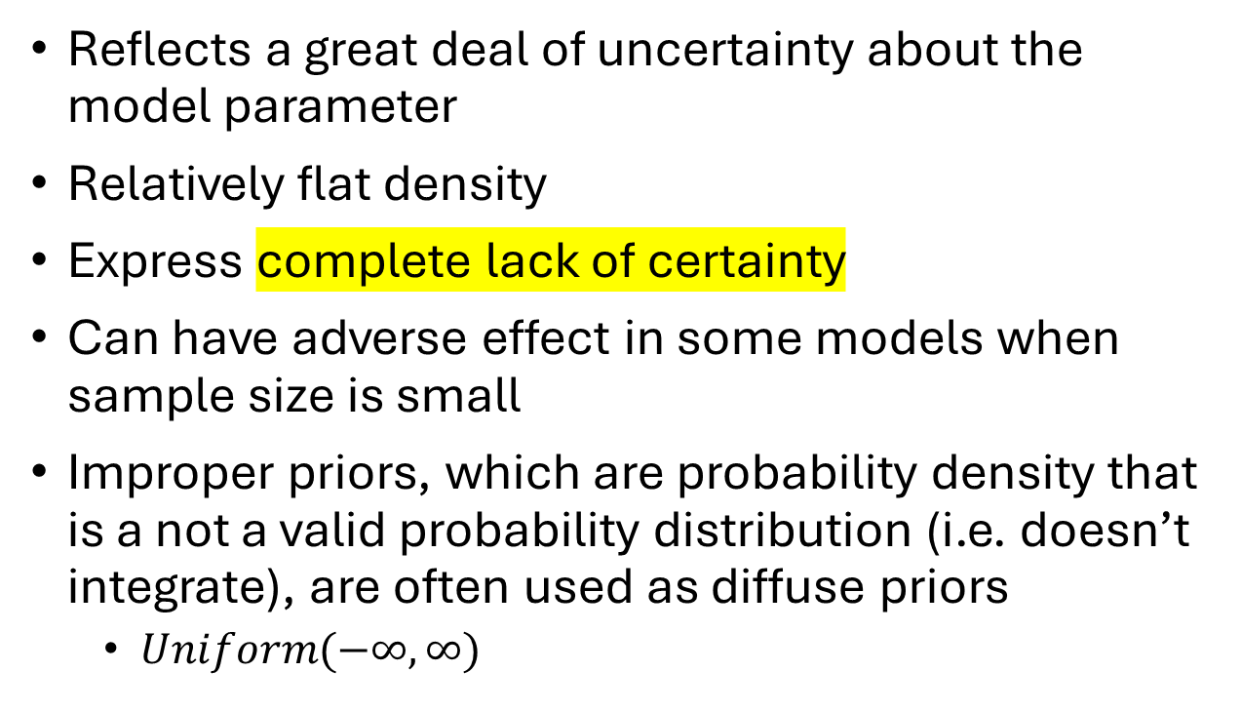
Diffuse (Non-informative) Prior
Reflects a great deal of uncertainty about the model parameter
Relatively flat density
Express complete lack of certainty
Can have adverse effect in some models when sample size is small
Improper priors, which are probability density that is a not a valid probability distribution (i.e. doesn’t integrate), are often used as diffuse priors
$Uniform(−∞, ∞)$

Slide 20
Guidelines on Choosing Prior
There is no universally “right” or “wrong” prior setting
Modern recommendation is to use weakly informative priors
Some useful principles include:
It should contain enough information to rule out unreasonable values but allow the parameter to move to plausible values
If using informative prior, provide justifications
What’s important is that you understand the implication of the prior choice through prior predictive checking
Comprehensive guideline here:
https://github.com/stan-dev/stan/wiki/Prior-Choice-Recommendations

Slide 21

Likelihood: $P(y|θ)$
Defines the model for generating your data given the parameter values
In other word, function for probability of your data given the model and parameter value
Using the text from unknown number as an example, likelihood function would be a probability function that calculates: “Given that the texter is Alex, how likely is it for them to text me?”

Slide 22
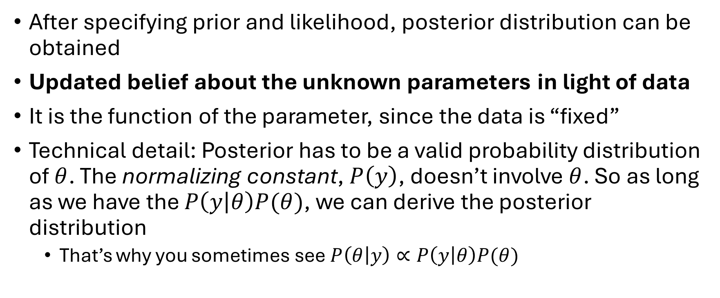

Posterior: $P(θ|y)$
After specifying prior and likelihood, posterior distribution can be obtained
Updated belief about the unknown parameters in light of data
It is the function of the parameter, since the data is “fixed”
Technical detail: Posterior has to be a valid probability distribution of $θ$. The normalizing constant, $P\left(y\right)$, doesn’t involve $θ$. So as long as we have the $P\left(y | θ\right)P(θ)$, we can derive the posterior distribution
That’s why you sometimes see $P\left(θ | y\right)∝P\left(y | θ\right)P(θ)$

Slide 23
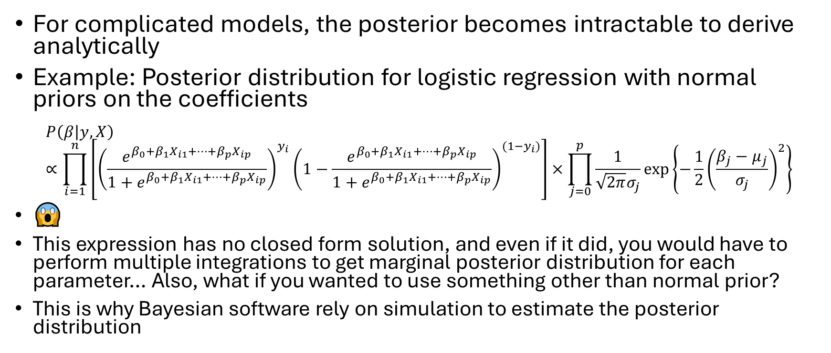
Posterior: $P(θ|y)$
For complicated models, the posterior becomes intractable to derive analytically
Example: Posterior distribution for logistic regression with normal priors on the coefficients
$$P\left(β | y,X\right)∝\prod_{i=1}^{n}{\left[{\left(\frac{e^{β_{0}+β_{1}X_{i1}+…+β_{p}X_{ip}}}{1+e^{β_{0}+β_{1}X_{i1}+…+β_{p}X_{ip}}}\right)}^{y_{i}}{\left(1−\frac{e^{β_{0}+β_{1}X_{i1}+…+β_{p}X_{ip}}}{1+e^{β_{0}+β_{1}X_{i1}+…+β_{p}X_{ip}}}\right)}^{{(1−y}_{i})}\right]}×\prod_{j=0}^{p}{\frac{1}{\sqrt{2π}σ_{j}}exp⁡\left\{−\frac{1}{2}{\left(\frac{β_{j}−μ_{j}}{σ_{j}}\right)}^{2}\right\}}$$
😱
This expression has no closed form solution, and even if it did, you would have to perform multiple integrations to get marginal posterior distribution for each parameter… Also, what if you wanted to use something other than normal prior?
This is why Bayesian software rely on simulation to estimate the posterior distribution

Slide 24

Posterior: $P(θ|y)$
For complicated models, the posterior becomes intractable to derive analytically
Example: Posterior distribution for logistic regression with normal priors on the coefficients:
$$P\left(β | y,X\right)∝\prod_{i=1}^{n}{\left[{\left(\frac{e^{β_{0}+β_{1}X_{i1}+…+β_{p}X_{ip}}}{1+e^{β_{0}+β_{1}X_{i1}+…+β_{p}X_{ip}}}\right)}^{y_{i}}{\left(1−\frac{e^{β_{0}+β_{1}X_{i1}+…+β_{p}X_{ip}}}{1+e^{β_{0}+β_{1}X_{i1}+…+β_{p}X_{ip}}}\right)}^{{(1−y}_{i})}\right]}×\prod_{j=0}^{p}{\frac{1}{\sqrt{2π}σ_{j}}exp⁡\left\{−\frac{1}{2}{\left(\frac{β_{j}−μ_{j}}{σ_{j}}\right)}^{2}\right\}}$$
😱
This expression has no closed form solution, and even if it did, you would have to perform multiple integrations to get marginal posterior distribution for each parameter… Also, what if you wanted to use something other than normal prior?
This is why Bayesian software rely on simulation to estimate the posterior distribution

Slide 25
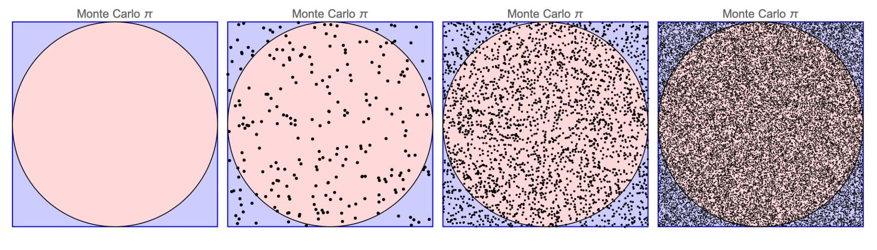
MCMC – Markov Chain Monte Carlo
Monte Carlo is an approach where we use computing algorithm and random sampling to obtain numerical results
In the image below, if we sample random points within the square, we can estimate the area of the circle by using the proportion of points that fall inside the circle vs outside
The estimate gets more accurate as we sample more points

Slide 26
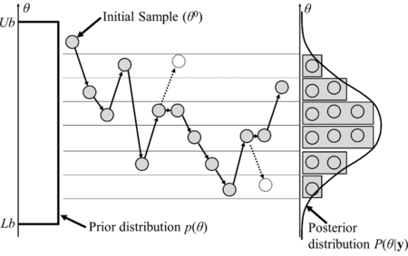
MCMC – Markov Chain Monte Carlo
MCMC is a special class of Monte Carlo method for drawing samples from a probability distribution that are too complex or high dimensional to derive analytically
For example, if you want to sample from normal distribution in R, you would use rnorm(). Similarly, MCMC lets you sample from posterior distribution.

Slide 27
Now that we have samples from the posterior, what can we do?
(Actually, first you want to make sure that the model has fitted to the data well. We call this process posterior predictive checking)
Summarize the posterior distribution for parameters of interest
Mean, median, mode
Construct credible intervals (e.g. 95% interval where the parameter likely lies)
Construct highest posterior density (HPD) region. This is the smallest possible credible region for given probability
Generate predictions using posterior
If you have multiple candidate models, compare and select models using LOO-CV or WAIC

Slide 28








Bayesian Modeling Overview
Likelihood
$$P(y|θ)$$
Prior
$$P(θ)$$
MCMC
Posterior
$$\hat{P}(θ|y)$$
$$θ^{(1)},θ^{(2)},θ^{(3)},θ^{(4)},…$$
Data
$$y$$

Slide 29
Bayesian Analysis Workflow
Identify the data relevant to your research question.
What are the variables used for prediction / analysis?
What is the quantity being predicted?
Specify the model
Define the likelihood function
Choose appropriate priors for unknown parameters based on domain knowledge
If possible, conduct prior predictive check -> understand what your prior implies
Compute/estimate posterior distribution
Assess convergence of MCMC methods
Conduct posterior predictive checks
Conduct inference using posterior
Summarize posterior distribution
Compute posterior probabilities
Make predictions

Slide 30
Bayesian Modeling in R with brms
Bayesian Regression Models using Stan
brms is an R package that provides high-level interface to fit generalized (non-) linear multivariate multilevel models using Stan
Stan is a programming language for Bayesian modeling
Syntax to define the model is very similar to that of lme4 package

Slide 31
Let’s Move over to R Studio!

Slide 32
Extra material

Slide 33
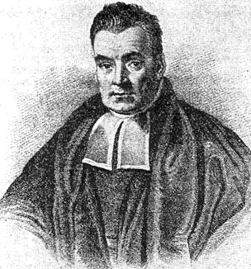
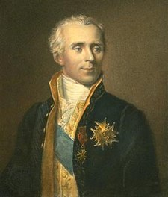
Brief History
Bayes’ theorem is named after Thomas Bayes (1701-1761), an English statistician, philosopher, and minister who developed a method for updating probabilities based on new evidence
Bayes’ work was not published during his lifetime; his friend Richard Price posthumously published his essay in 1763
Pierre-Simon Laplace (1749-1827) independently arrived to a similar idea and later discovered Bayes’ paper, confirming his belief
Laplace generalized and formulated the Bayes’ theorem in the form that we see today, setting the foundation of modern Bayesian inference
Thomas Bayes
Pierre-Simon Laplace

Slide 34


Quick Experiment
Suppose that I have a red ball and a blue ball
I close my eyes and throw the red ball on a wooden plank (2-d), and I want to guess approximately where the red ball lies horizontally
For simplicity, suppose that the ball has an equal chance landing anywhere
* In this illustration, I will use the transparency of the ball to represent uncertainty

Slide 35
Quick Experiment
I have my trusty assistant throw the blue ball in the same manner and I have them tell whether it landed on the left or right side.
They tell me it landed on the left side!
How would that change my belief as to where the red ball landed?
Counter
Left: 1 | Right: 0

Slide 36
Quick Experiment
I have my trusty assistant throw the blue ball in the same manner and I have them tell whether if it landed on the left or right side.
They tell me it landed on the left side!
How would that change my belief as to where the red ball landed?
Counter
Left: 1 | Right: 0

Slide 37
Quick Experiment
I repeat this 4 more times.
I’ve been told that the blue ball landed on the left side of the red every time.
How would that affect my belief?
Counter
Left: 5 | Right: 0

Slide 38
Quick Experiment
I repeat this 4 more times.
I’ve been told that the blue ball landed on the left side of the red every time.
How would that affect my belief?
Counter
Left: 5 | Right: 0

Slide 39
Quick Experiment
I repeat this 5 more times.
I’ve been told that the blue ball landed on the right side every time!
How would that affect my belief?
1
2
3
Counter
Left: 5 | Right: 5

Slide 40
Bayesian Inference is a process of updating beliefs as new data becomes available
Data
Left: 0 | Right: 0
Data
Left: 1 | Right: 0
Data
Left: 5 | Right: 0
Data
Left: 5 | Right: 5

